Slide 1
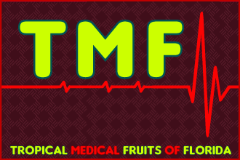
TMF Florida – Health Report
International Lifestyle Sciences Institute (ILSI) - EU Study:
Europeans DO NOT Consume Enough Vitamins and Minerals
Website: www.TMFflorida.com Email: TropicalMedicalFruits@gmail.com Tel: (+1) 561-792-5925 Skype: TMF.FLORIDA (English – Deutsch – Español)

Slide 2
International Life Sciences Institute (ILSI) – EU Study
TMF Florida - Article
A group of researchers from the International Life Sciences Institute (ILSI Europe) has evaluated the low intake of 17 micronutrients in eight European countries: Belgium, Denmark, France, Germany, the Netherlands, Poland, the United Kingdom and Spain.
"Better understanding the scope of micronutrient adequacy across Europe is a significant challenge," explain the authors of the study, which was published this year in the British Journal of Nutrition.
The experts believe that, despite the fact that current European policies on nutrition focus fundamentally on tackling problems to do with excessive consumption, not much is known across the continent about the optimal intake of micronutrients. According to the authors, despite its limited data, this study provides "valuable information on micronutrient intake in Europe and the likelihood of its inadequacy country by country.“
The study analysed the intake of 17 basic micronutrients in people's diets across these eight European countries. The results reveal that, although vitamin D is the most extreme case, European citizens - across all age and sex ranges - do not consume sufficient iron, calcium, zinc, vitamin B1 (thiamine), vitamin B2 (riboflavin), vitamin B6 and folic acid.
"In the case of vitamins, low levels of consumption in all age and sex groups do not pose a risk except in the case of vitamin D," the experts continue. However, for minerals, the risk of inadequate intake is larger in certain groups depending on age.
"To our knowledge, this is the first time micronutrient consumption has been evaluated across several countries. Thus, it provides a better vision of micronutrient inadequacy in Europe and is a valuable resource for assessing the state of populations," they conclude.
For more information: Mensink G.B.M. et al. Mapping low intake of micronutrients across Europe, British Journal of Nutrition 2013; 14:1-19.
Website: www.TMFflorida.com Email: TropicalMedicalFruits@gmail.com Tel: (+1) 561-792-5925 Skype: TMF.FLORIDA (English – Deutsch – Español)

Slide 3
AESAN Study – Micronutrients in the Spanish Diet
TMF Florida - Article
According to data from the National Survey on Dietary Intake conducted recently by the Spanish Agency for Food Safety and Nutrition (AESAN), the case of Spain is particular.
From all the values analysed we can conclude that average micronutrient consumption exceeds 80% of the reference dietary intakes (RDI’s / RDA’s), except in the case of zinc, iron in women of childbearing age, vitamin A, vitamin D and folic acid, in which inadequate intake can be observed.
The AESAN survey concludes: "The modern Spanish diet is a western-type diet, further and further removed from typical Mediterranean cuisine, although this gap is lower than expected due to the population's high consumption of fish.“
As such, the data show very low intakes of vegetables, fruits and their derivatives, low consumption of cereals, mainly refined, and high intake of meats and their derivatives and products prepared with high sodium, fat and added sugar content.
Source: www.edicalxpress.com/news/2013-11-europeans-consume-vitamins-minerals.html
For more information: Mensink G.B.M. et al. Mapping low intake of micronutrients across Europe, British Journal of Nutrition 2013; 14:1-19.
Website: www.TMFflorida.com Email: TropicalMedicalFruits@gmail.com Tel: (+1) 561-792-5925 Skype: TMF.FLORIDA (English – Deutsch – Español)

Slide 4
TMF Florida - Article
Re: AESAN Study Reference Daily Intakes (RDI’s):
“Recommended Daily Allowances (RDA’s)
do little or nothing to prevent against our
epidemic of chronic degenerative diseases.”
- American Medical Association (AMA)
Website: www.TMFflorida.com Email: TropicalMedicalFruits@gmail.com Tel: (+1) 561-792-5925 Skype: TMF.FLORIDA (English – Deutsch – Español)

Slide 5
TMF Florida - Article
“70-80% of all diseases
in DEVELOPED COUNTRIES
are due to CLINICAL MALNUTRITION.”
- World Health Organization (W.H.O.)
Website: www.TMFflorida.com Email: TropicalMedicalFruits@gmail.com Tel: (+1) 561-792-5925 Skype: TMF.FLORIDA (English – Deutsch – Español)

Slide 6
World Health Organization – “Clinical Malnutrition”
TMF Florida - Article
Nutritional deficiencies are strongly related to, and considered by an ever-increasing number of modern medical doctors, scientists, researchers and health organizations … to be the primary underlying cause of innumerable chronic degenerative disease conditions (and birth defects) which plague industrialized and processed-food cultures.
Vast international scientific medical research support these facts (see research database - www.nutrionomics.com).
“70-80% of all diseases in DEVELOPED COUNTRIES ... are due to CLINICAL MALNUTRITION.” - World Health Organization (W.H.O.)
World Health Organization technical report series ; 916: “DIET, NUTRITION AND THE PREVENTION OFCHRONIC DISEASES” ... a report of a joint WHO/FAO expert consultation, Geneva, 28 January -- 1 February 2002. (WHO):
1.Chronic disease -epidemiology 2.Diet – standards 3.Feeding behavior
4.Energy metabolism 5.Motor activity 6.Cost of illness
More info: www.nutrionomics.com/Article%20-%20WHO/WHO_Chronic_Disease.pdf
Due to nutritional deficiencies … the deteriorating health of the average European citizen will reduce overall quality of life, restrict daily exercise and leisure activities, decrease work productivity and performance ... placing an enormous (and ever-increasing) health and economic burden upon the national healthcare systems and Governments throughout the EU.
Website: www.TMFflorida.com Email: TropicalMedicalFruits@gmail.com Tel: (+1) 561-792-5925 Skype: TMF.FLORIDA (English – Deutsch – Español)

Slide 7
TMF Florida - Article
Vitamin & Mineral
RDA
(Recommended Daily Allowance)
Website: www.TMFflorida.com Email: TropicalMedicalFruits@gmail.com Tel: (+1) 561-792-5925 Skype: TMF.FLORIDA (English – Deutsch – Español)

Slide 8
RDA’s – Australia & New Zealand Government Studies
TMF Florida - Article
“There is some evidence that a range of nutrients could have benefits in chronic disease aetiology at levels above the RDI. This is discussed in detail in the publications of the Food and Nutrition Board: Institute of Medicine as part of the reviews of the US:Canadian DRI’s, notably those published in 1998, 2000 and 2002.
The nutrients for which higher than RDI intakes have been linked to benefits for chronic disease risk include the antioxidant vitamins such as vitamin C, vitamin E and vitamin A (primarily its precursor, ß-carotene) as well as selenium and nutrients such as folate, omega 3 fats and dietary fibre.
These nutrients have been assessed in relation to heart disease and cancer … degenerative eye diseases such as cataract formation or macular degeneration … and conditions like Alzheimer's or cognitive decline.
The Nutrient Reference Values (NRVs) was a joint initiative of the …
Australian National Health and Medical Research Council (NHMRC) and the New Zealand Ministry of Health (MoH)
Source: www.nrv.gov.au/disease/introduction.htm
Website: www.TMFflorida.com Email: TropicalMedicalFruits@gmail.com Tel: (+1) 561-792-5925 Skype: TMF.FLORIDA (English – Deutsch – Español)

Slide 9
TMF Florida - Article
“One quick word about the so-called Recommended Daily Allowances:
Nonsense!
I believe they're just too low. These daily allowances, until recently, where called "Minimum Daily Requirements."
But then someone with a good sense of public relations realized that most people want more than just the "minimum."
So they changed "Minimum" to "Recommended" - but still left the amount at approximately the same low levels.”
- Dr. Dharma Singh Khalsa
Website: www.TMFflorida.com Email: TropicalMedicalFruits@gmail.com Tel: (+1) 561-792-5925 Skype: TMF.FLORIDA (English – Deutsch – Español)

Slide 10
RDA = “Ridiculous Daily Allowance” – by Hickey & Robert
TMF Florida - Article
“Many people consuming RDA levels of vitamins are likely to suffer from deficiency disease and premature death. Current official recommendations for nutrient intakes are inappropriate.
As this book demonstrates, the recommended dietary intake for vitamin C owes more to politics and prejudice than to science. Furthermore, the research behind the RDA values for vitamin C is biased and insubstantial.
This book presents an open challenge to the government "experts", who support the out-of-date RDA approach to nutrition and thereby endanger the health of the entire population. For people who value the peer review process, this book was read by thousands, including doctors and scientists.
The readers reported no significant scientific errors. The authors therefore assert that the RDA and the Codex justification for low intakes of vitamin C are both invalid and indefensible.”
RDA - Ridiculous Dietary Allowance (Paperback) - by Steve Hickey (Author) , Hilary Roberts (Author)
Source: www.lulu.com/spotlight/ascorbate
Website: www.TMFflorida.com Email: TropicalMedicalFruits@gmail.com Tel: (+1) 561-792-5925 Skype: TMF.FLORIDA (English – Deutsch – Español)

Slide 11
TMF Florida - Article
Vitamin C
RDA
(Recommended Daily Allowance)
Website: www.TMFflorida.com Email: TropicalMedicalFruits@gmail.com Tel: (+1) 561-792-5925 Skype: TMF.FLORIDA (English – Deutsch – Español)

Slide 12
Vitamin C … in Humans vs Nature
TMF Florida - Article
According to the U.S Government, the FDA and its medical and scientific advisors (and repeated by their European equivalents) … they recommend the average human being to take 60-95 mg of Vitamin C daily.
Let’s put that into perspective …
For example, by comparing an average human weighing 140lbs versus a mammal of similar size:
“A 140lb goat will produce about 13,000 mg (13 grams) of vitamin C every day. That's enough to keep him healthy in most circumstances. But if he's wounded or suffers a massive infection, the goat -- and virtually all other wild animals -- can synthesize as much as 100,000 additional mgs (100 grams) of vitamin C to get him through the crisis. Humans cannot do that.
Humans are one of the few animals that cannot produce vitamin C. Most other animals can. Since few of us take 13,000 mg a day of oral vitamin C, we get sick in staggering numbers.”
Source: http://owen.curezone.com/nutrition/benefitsofc.html
Website: www.TMFflorida.com Email: TropicalMedicalFruits@gmail.com Tel: (+1) 561-792-5925 Skype: TMF.FLORIDA (English – Deutsch – Español)

Slide 13
US Vitamin C Foundation’s Recommended Daily Allowance
TMF Florida - Article
RDA: 3000 mg Vitamin C … 1000 mg three times per day
The Vitamin C Foundation recommends that every man, woman and child
over the age of 3 consume at least 3 g (3000 mg) vitamin C daily
in order to enjoy optimum health.
More during pregnancy (6000 mg) …
and much more during periods of disease (20,000 to 300,000 mg).
Source: http://www.vitamincfoundation.org/vitcrda.shtml
Website: www.TMFflorida.com Email: TropicalMedicalFruits@gmail.com Tel: (+1) 561-792-5925 Skype: TMF.FLORIDA (English – Deutsch – Español)

Slide 14
RDA Chart - A Comparison of Vitamin C “Experts”
TMF Florida - Article
RDI / RDA | Source / Population
60-95 mg | U.S. Government / FDA Recommended Intake
200 mg | Levin / NIH Recommendation
400 mg (recently increased) | Linus Pauling Institute Recommendation
2500 mg | Hickey / Roberts Minimum
3000 mg | Vit C Foundation’s Daily Recommendation
6000 - 12,000 mg | Levy’s Daily Recommendation
6000 - 18,000 mg | Linus Pauling’s Daily Recommendation
6000 - 9000 mg | Pregnancy
6000 - 18,000 mg | Heart Disease
14,000 - 30,000 mg | Cancer
20,000 – 300,000 mg | Cathcart / Levy Cure for Infectious Diseases
Source: http://www.vitamincfoundation.org/vitcrda.shtml
Website: www.TMFflorida.com Email: TropicalMedicalFruits@gmail.com Tel: (+1) 561-792-5925 Skype: TMF.FLORIDA (English – Deutsch – Español)

Slide 15
TMF Florida - Article
Vitamin C Research
Website: www.TMFflorida.com Email: TropicalMedicalFruits@gmail.com Tel: (+1) 561-792-5925 Skype: TMF.FLORIDA (English – Deutsch – Español)

Slide 16
Part 1 - Vitamin C Medical Studies Research – by Dr. Levy
TMF Florida - Article
Dr. Levy exhaustively researched the existing medical literature on vitamin C for the last 70 years. Here's a short list of illnesses which doctors have CURED or PREVENTED using mega-doses of vitamin C through drip-needles.
(1) Acute Hepatitis | (7) Viral Pneumonia
(2) Polio | (8) Streptococcal infections
(3) Measles | (9) Dysentery
(4) Mumps | (10) Diptheria
(5) Chicken Pox | (11) Influenza
(6) Herpes
Medical Book: VITAMIN C, INFECTIOUS DISEASES, AND TOXINS – by Dr. Thomas Levy
Source: www.owen.curezone.com/nutrition/benefitsofc.html
Website: www.TMFflorida.com Email: TropicalMedicalFruits@gmail.com Tel: (+1) 561-792-5925 Skype: TMF.FLORIDA (English – Deutsch – Español)

Slide 17
Part 1 - Vitamin C Medical Studies Research – by Dr. Levy
TMF Florida - Article
Another list of medical horrors Dr. Levy says are REVERSIBLE and PREVENTABLE with high-dose Vitamin C:
(1) HIV | (3) Typhoid Fever
(2) Tuberculosis | (4) Leprosy
Dr. Levy adds that "both Lupus and MS respond well to high-dose vitamin C therapy." (p.404).
Vitamin C has also been used successfully to treat the following poisonings:
(1) Carbon Monoxide | (5) Radiation
(2) Alcohol | (6) All Heavy Metals
(3) Barbiturates | (7) Mushrooms
(4) Pesticides | (8) Snake & Spider Venom
Medical Book: VITAMIN C, INFECTIOUS DISEASES, AND TOXINS – by Dr. Thomas Levy
Website: www.TMFflorida.com Email: TropicalMedicalFruits@gmail.com Tel: (+1) 561-792-5925 Skype: TMF.FLORIDA (English – Deutsch – Español)

Slide 18
Vitamin C - Polio Cure - by Dr. Frederick Klenner
TMF Florida - Article
Dr. Frederick Klenner performed much of the ground-breaking medical research with mega-doses of vitamin C (in the U.S.) back in the 1940s and 1950s!
In 1949, Dr. Klenner CURED 60 out of 60 polio patients -- all within 72 hours!
… by giving them massive doses of intravenous vitamin C. None of the patients suffered any of the deformities common to polio patients.
Medical Book: VITAMIN C, INFECTIOUS DISEASES, AND TOXINS – by Dr. Thomas Levy
Source: www.owen.curezone.com/nutrition/benefitsofc.html
Website: www.TMFflorida.com Email: TropicalMedicalFruits@gmail.com Tel: (+1) 561-792-5925 Skype: TMF.FLORIDA (English – Deutsch – Español)

Slide 19
Can You Overdose on Vitamin C ???
TMF Florida - Article
Can you overdose on vitamin C? … the answer is "NO!“
"In Australia alone," says Dr. Levy, some 100 physicians have administered as much as 300,000 mg of vitamin C PER DAY to their patients. In most cases, the results have been spectacular.
… the only side effect is chronic good health.“ Loose stools and mild diarrhea will indicate Vitamin C “bowel tolerance”. Dr. Levy says that chronic cancer patients can have bowel tolerances of 100,000 mg or higher.
Medical Book: VITAMIN C, INFECTIOUS DISEASES, AND TOXINS – by Dr. Thomas Levy
Dr. Levy's website is: www.peakenergy.com
N.B. If you wish to follow a mega-dose vitamin C regimen, it would be preferable to take it in bio-natural form of fruits, such as, Acerola Cherry, Camu Camu Berry, Kakadu Plum, Indian Gooseberry, Rose Hips, Yellow Jaboticaba etc.
Alternatively, there is the option for IV medical treatments, or at-home supplements … (ideally, in nature’s form of “L-ascorbic acid” (C6H8O6), or “sodium ascorbate” – as opposed to the more acidic form of “ascorbic acid”).
Website: www.TMFflorida.com Email: TropicalMedicalFruits@gmail.com Tel: (+1) 561-792-5925 Skype: TMF.FLORIDA (English – Deutsch – Español)

Slide 20
Does Vitamin C Cause Kidney Stones ???
TMF Florida - Article
Does vitamin C cause kidney stones … the answer is "NO!"
Vitamin C does NOT cause the formation of kidney stones. That's one of those misinformation campaigns that has been floated by the pharmaceutical industry and the allopathic medical community.
Doctor Levy discusses this on pp. 385-390 of his book: VITAMIN C, INFECTIOUS DISEASES, AND TOXINS – by Dr. Thomas Levy
Dr. Levy's website is: www.peakenergy.com
Source: www.owen.curezone.com/nutrition/benefitsofc.html
Further information on the “real” causes of kidney stones (nutritional deficiencies) can be found here:
http://orthomolecular.org/resources/omns/v09n05.shtml
http://www.drwhitaker.com/magnesium-for-kidney-stones/
Website: www.TMFflorida.com Email: TropicalMedicalFruits@gmail.com Tel: (+1) 561-792-5925 Skype: TMF.FLORIDA (English – Deutsch – Español)

Slide 21
Mega-Dose Vitamin C Fruits – TMF Florida
TMF Florida - Article
If you wish to embrace mega-dose vitamin C as a daily health regimen, it is possible to consume optimal amounts in the ideal bio-natural form ... from plants, and many popular tropical and sub-tropical fruits:
Fruit Name | Latin Name | Vitamin C per 100g Serving
Acerola Cherry | Malpighia emarginata | 1500 to 4600+ mg
Camu Camu Berry | Myrciaria dubia | 1500 to 2800 mg
Kakadu Plum | Terminalia ferdinandiana | 2000 to 3100 mg
Indian Gooseberry | Phyllanthus emblica | 500 to 1800 mg
Rose Hips | Rosa | 1700 to 6900+ mg
Yellow Jaboticaba | Myrciaria glomerata | 700 to 2400 mg
Source: www.TMFflorida.com
Website: www.TMFflorida.com Email: TropicalMedicalFruits@gmail.com Tel: (+1) 561-792-5925 Skype: TMF.FLORIDA (English – Deutsch – Español)

Slide 22
Vitamin C - Over 80,000+ Scientific Medical Studies!!!
TMF Florida - Article
What may seem even more extraordinary is … the vast amounts of vitamin C international medical research available … 80,000+ Vitamin C studies! … spanning 70+ years! … 1,000,000’s of patient applications worldwide!
As well as, the enormous (and ever-increasing) flow of Vitamin C medicine production and sales.
And yet … even with numerous intravenous vitamin C medical clinics popping up in the U.S. and established throughout the world … a large number of Western-trained Doctors … and the vast majority of Western Citizens … have little (or no) knowledge that Vitamin C therapy exists … let alone its immense abilities to reverse many of the diseases that plague Western societies… or the “enormous and non-toxic dosages” used to “cure” these diseases.
In a “Utopian Society” … this medical knowledge would be embraced by leaders for the good of the population ... and made standard education throughout children’s schooling and medical training … as well as, at the forefront of mainstream news media and via Government healthcare systems … readily available and accessible t0 all patients.
Website: www.TMFflorida.com Email: TropicalMedicalFruits@gmail.com Tel: (+1) 561-792-5925 Skype: TMF.FLORIDA (English – Deutsch – Español)

Slide 23
TMF Florida - Article
Vitamin & Mineral
RDA
Sumary
Website: www.TMFflorida.com Email: TropicalMedicalFruits@gmail.com Tel: (+1) 561-792-5925 Skype: TMF.FLORIDA (English – Deutsch – Español)

Slide 24
TMF Florida - Article
“A large proportion of the general (U.S.) population”
has less-than-optimal intakes of a number of vitamins,
exposing them to increased disease risk … it appears
prudent for all adults to take vitamin supplements.”
- American Medical Association (AMA)
Source: www.mreassociates.org/pages/ama_speaks_out.html
Website: www.TMFflorida.com Email: TropicalMedicalFruits@gmail.com Tel: (+1) 561-792-5925 Skype: TMF.FLORIDA (English – Deutsch – Español)

Slide 25
RDA’s - What is a Good Regimen for Maintaining Health?
TMF Florida - Article
We do not like to overwhelm people who are not used to taking vitamins and minerals, so we start them off with the basics for almost anyone. Check out the difference between the RDA and doses recommended by Holistic doctors, Naturopaths and Nutritionists – Dr. Cherie, New York
Source: www.drcherie.hubpages.com/hub/Vitamins-How-Much-Is-Enough
Vitamin / Mineral | Current RDA | Optimal Intake | % RDA Difference
Vitamin A | 5000 IU | 15,000 IU | 300 %
Vitamin C | 59.9 | 3000 - 6000 mg | 5,000 – 10,000 %
Vitamin E | 30 IU | 450 IU | 1,500 %
Vitamin B1 | 1.5 mg | 27 mg | 1,800 %
Vitamin B6 | 2.o mg | 27 mg | 1,350 %
Selenium | 70 mcg | 200 mcg | 285 %
Website: www.TMFflorida.com Email: TropicalMedicalFruits@gmail.com Tel: (+1) 561-792-5925 Skype: TMF.FLORIDA (English – Deutsch – Español)

Slide 26
TMF Florida - Article
The “Recommended Daily Allowances” for vitamins and minerals are proving to be “grossly insufficient” in preventing the growing plague of chronic degenerative disease spreading throughout modern Western culture … a situation that is both “preventable” and ”reversible” when sufficient nutritional tools are made available to the human body.
Nutritional deficiency-related clinical symptoms are now highly prevalent in school children and young adults … degenerative disease in humans is reaching a critical point.
Website: www.TMFflorida.com Email: TropicalMedicalFruits@gmail.com Tel: (+1) 561-792-5925 Skype: TMF.FLORIDA (English – Deutsch – Español)

Slide 27
TMF Florida - Article
TMF Florida has solutions
… … …
Website: www.TMFflorida.com Email: TropicalMedicalFruits@gmail.com Tel: (+1) 561-792-5925 Skype: TMF.FLORIDA (English – Deutsch – Español)

Slide 28
Low Nutrient Foods … vs High Nutrient Foods?
TMF Florida - Article
In Western cultures, it is common for citizens to see, read, hear and believe that eating “xyz” portions of fruits and vegetables per day will provide a ”sufficient daily intake” of vitamins and minerals (to “maintain health”) … and this certainly could be achieved “if “ those food sources were from more “nutrient-dense” fruits and food varieties.
After all, some foods can have 100’s of times more nutrients in the same serving sizes when compared to others. In which case, even “10” portions and multiple varieties of low nutrient foods will not equal “1” portion of a nutrient dense food. Imagine the nutritional benefits of eating “5” or “10” nutrient-dense fruits and foods instead! (see charts below)
Unfortunately, many popular mainstream Western fruits and vegetables are often very low sources of vitamins and minerals. In addition, many foods may also be grown in soils over-farmed and depleted of nutrients and / or poisoned by harmful chemicals … further reducing the already naturally low nutrient values of these foods. Whereas, other countries and cultures tend to embrace, grow and trade in more nutrient-dense varieties of fruits and vegetables.
So, there is hope … throughout the rest of the world, it is “common” to feast regularly upon a wide variety of natural tropical and sub-tropical fruits, vegetables, and medicinal plants … many of which are packed with x20, x50 and x100’s more vitamins and minerals (and other nutrients) when compared with popular mainstream Western foods.
Website: www.TMFflorida.com Email: TropicalMedicalFruits@gmail.com Tel: (+1) 561-792-5925 Skype: TMF.FLORIDA (English – Deutsch – Español)

Slide 29
TMF Florida … Health and Trade Solutions
TMF Florida - Article
TMF Florida offers the much-needed health and trade solutions for the EU and US markets.
TMF Florida is an international export / import company based in South Florida, USA. (www.tmfflorida.com)
TMF Florida trades primarily in high quality, nutrient-dense fresh fruits and foods grown in the optimal climates and fertile soils of the tropical and sub-tropical regions of South Florida, the Caribbean, South and Central America.
TMF Florida offers a variety of nutrient-dense products, including delicious tropical fruits … many of which are packed with x20, x50 and x100+ more vitamins and minerals, as well as, superior anti-oxidants, amino acids, enzymes and other essential micro-nutrients, when compared to many popular mainstream Western fruits (see charts below).
TMF Florida offers nutrient-dense organic products grown using hydroponic, aeroponic and aquaponic technologies, optimal nutrient delivery techniques, consistent quality products and yields … while reducing carbon footprint.
TMF Florida may also supply other organic produce, dried and semi-dried produce, vegetables, micro-greens, ginger, fruit pulps, sweet potatoes, mushrooms, raw honey, nuts, grains, coffee, wine, extra virgin olive oil, herbs and spices.
Website: www.TMFflorida.com Email: TropicalMedicalFruits@gmail.com Tel: (+1) 561-792-5925 Skype: TMF.FLORIDA (English – Deutsch – Español)

Slide 30
TMF Florida - Article
TMF Florida
Tropical Fruits & Foods
vs
Common Western Fruits & Foods
Website: www.TMFflorida.com Email: TropicalMedicalFruits@gmail.com Tel: (+1) 561-792-5925 Skype: TMF.FLORIDA (English – Deutsch – Español)

Slide 31
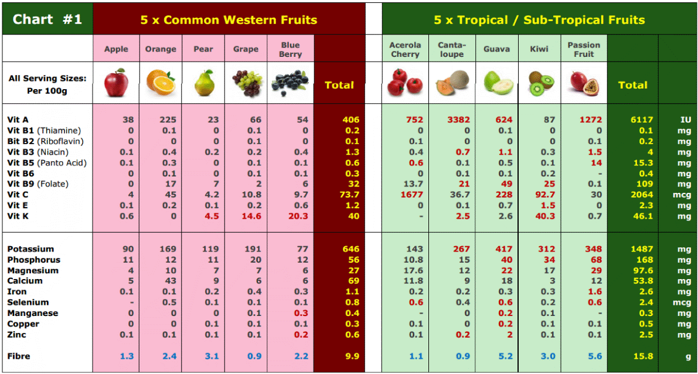

Slide 32
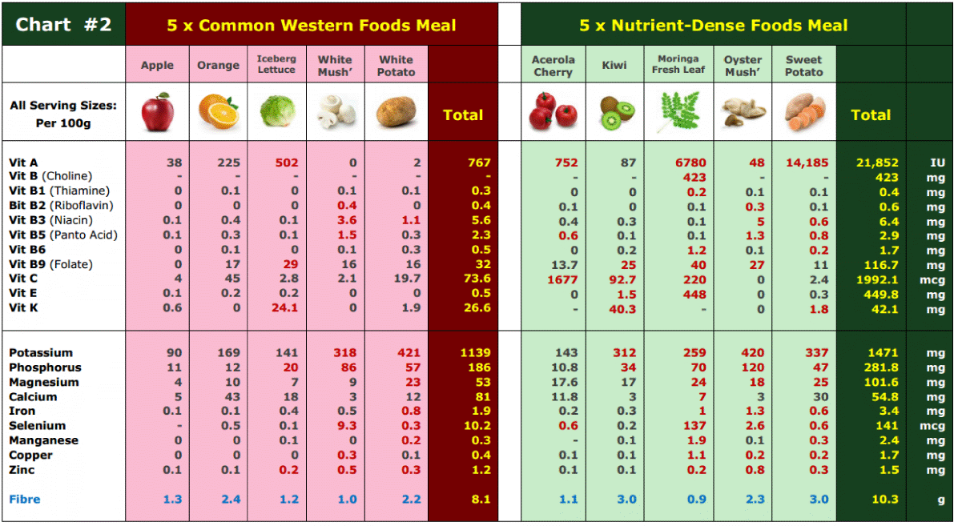

Slide 33
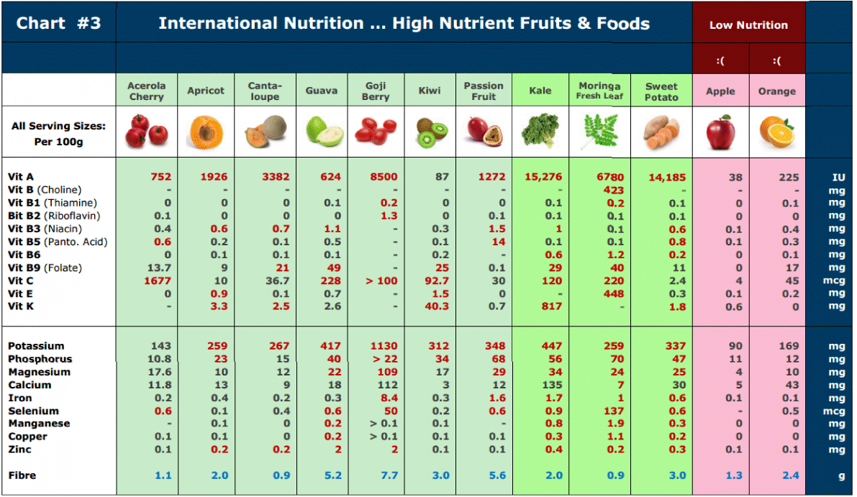

Slide 34
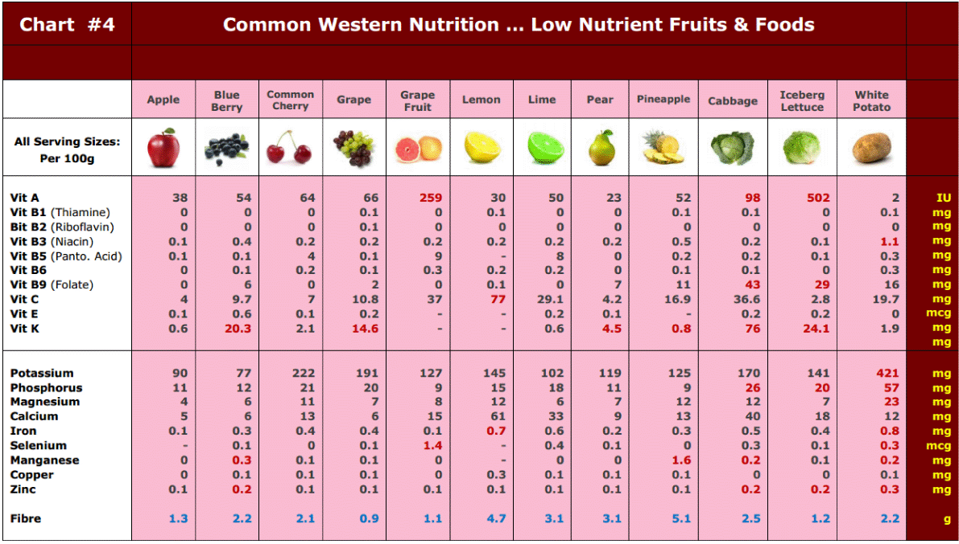

Slide 35
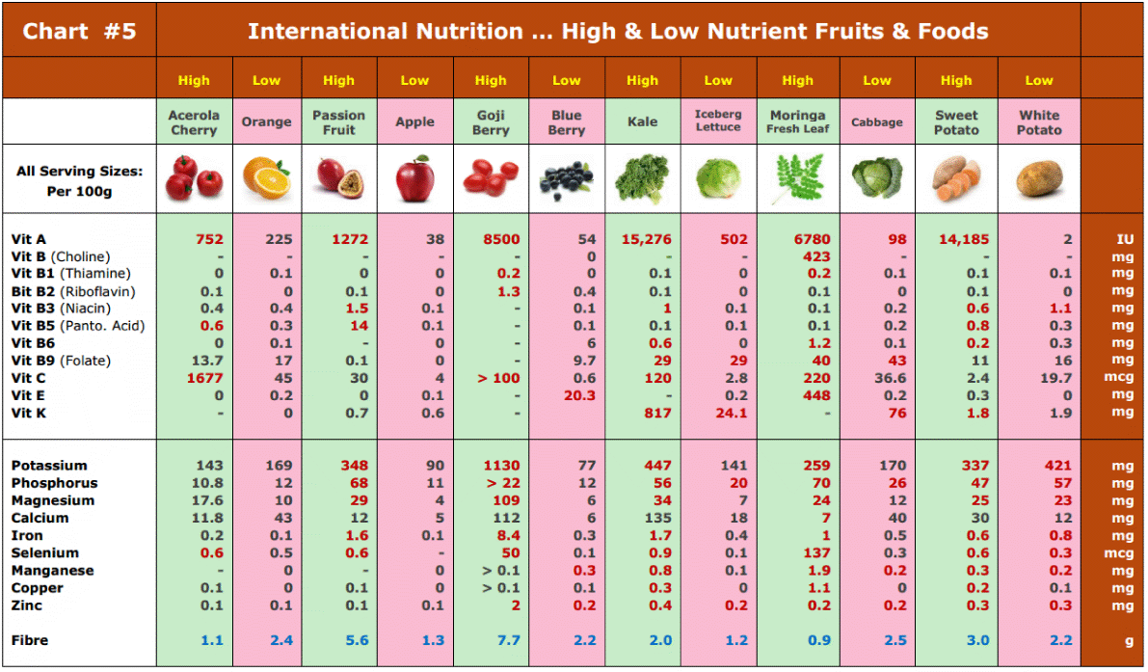

Slide 36
TMF Florida - Article
TMF Florida Quick Links:
http://tmfflorida.com/images_profiles_PDF/store_fruits_a_to_z_A4.pdf
http://tmfflorida.com/images_profiles_PDF/store_5_per_day.pdf
http://tmfflorida.com/images_profiles_PDF/store_moringa_A4.pdf
http://tmfflorida.com/commercial_info.html
http://tmfflorida.com/images_trade_info/TMF_presentation.pdf
http://tmfflorida.com/contact.html
Website: www.TMFflorida.com Email: TropicalMedicalFruits@gmail.com Tel: (+1) 561-792-5925 Skype: TMF.FLORIDA (English – Deutsch – Español)

Slide 37
TMF Florida … a Subsidiary of Arvila LLC
TMF Florida - Article
Website: www.TMFflorida.com Email: TropicalMedicalFruits@gmail.com Tel: (+1) 561-792-5925 Skype: TMF.FLORIDA (English – Deutsch – Español)

Slide 38
TMF Florida … a Subsidiary of Arvila LLC
TMF Florida - Article
Website: www.TMFflorida.com Email: TropicalMedicalFruits@gmail.com Tel: (+1) 561-792-5925 Skype: TMF.FLORIDA (English – Deutsch – Español)

